Slide 1

Unit 16 – Procedural Programming
with Ben Read

Slide 2
AIMS & OBJECTIVES
Differentiate between scopes when declaring variables
Review the use of conditional statements, e.g. if()
Partake in a self-paced tutorial to revise programming concepts

Slide 3
VARIABLES BY SCOPE
Variables behave differently depending on which scope they are declared in
There are two primary scopes – global and local

Slide 4
VARIABLES BY SCOPE
Global variables are declared above the main() function and can be accessed from anywhere in the program –
#include <stdio.h>
int global1;
int main()
{
}

Slide 5
VARIABLES BY SCOPE
Local variables are declared within a particular statement block and can only be accessed by elements in the same scope. When a variable is declared within a function then it can be accessed by anything within that function’s scope -
#include <stdio.h>
int main()
{
int local1;
}

Slide 6
VARIABLES BY SCOPE
This rule applies to any scope. Therefore a variable can be declared inside the scope of an if() statement and will only be visible to that if() statement -
#include <stdio.h>
int main()
{
int local1 = 1;
if(local1 > 0)
{
int local2 = 2;
printf(“Local1 = %d, Local2 = %d\n”, local1, local2);
}
}

Slide 7
STATIC VARIABLES
Local variables which are declared inside functions only exist in memory while that function is being processed. Once the function completes its task and returns its value the contents of its local variables are destroyed.
Sometimes it is necessary to retain the value of a local variable, even after a function has completed processing. To do this we need to use a static local variable.
To declare a static variable, simply add the static keyword before the datatype, e.g.
static int integer1 = 10;

Slide 8
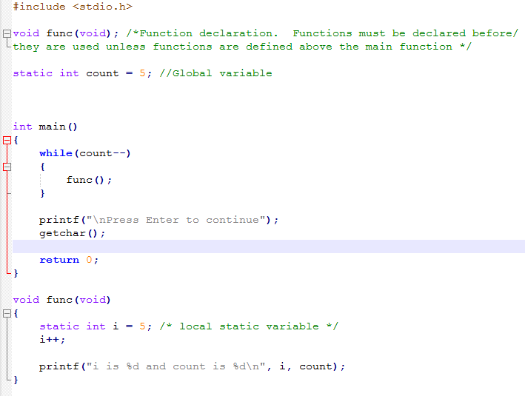
STATIC VARIABLES

Slide 9
IF CONDITIONAL STATEMENTS
If...Else is a branching statement. It is used to take an action based on a condition. For example - if the user inputs a valid account number and pin then allow their money withdrawal, otherwise deny them access.
An If() statement works like "If condition is met, then execute the task". It is used to compare things and take some action based on the comparison. Relational and logical operators support this comparison.

Slide 10
IF CONDITIONAL STATEMENTS
The C language supports three variants of the If statement.
Simple If statement
If...Else and If...Else...If statement
Nested If...Else statement
If statements perform actions based on boolean expressions, true or false.

Slide 11
SIMPLE IF STATEMENT SYNTAX
if(boolean_expression)
{
// body of if
}
In the above syntax if the boolean expression evaluates as true, then statements inside the if() body execute, otherwise they are skipped.

Slide 12
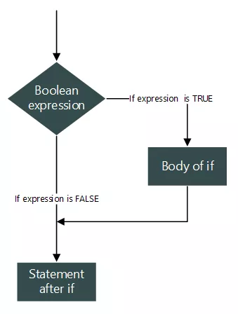
SIMPLE IF STATEMENT SYNTAX

Slide 13
SINGLE OR COMPOUND IF STATEMENTS
If there is only a single statement inside the if body, then braces { } are optional. However, braces after if statements are mandatory when the body of if contains more than one statement.
So, you can write an if() condition in two ways –
if(boolean_expression)
// Single statement inside if
OR
if(boolean_expression)
{
// Statement 1
// Statement 2
…
…
// Statement n
}

